Slide 1
Health and Work Week 5 The Physical Environment

Slide 2

Directed Study
Ofsted recently visited Hartwich Secondary Comprehensive School and gave it a rating of ‘failing’. They noted pupil behaviour was poor, that 12 of 50 staff had recently left or were absent citing stress or mental health issues.
The school is in one of the poorest parts of the country and the school receives pupil premium for 60% of its pupils. The school has a high number of teen pregnancies, a drug and alcohol unit, and a gang and sexual exploitation worker. Parents routinely are abusive to staff and students, and the police or social services are present at the school at least once each week. The newly appointed head has asked you to help him address the stress levels in his staff.

Slide 3
How did you answer?
In preparing how you will support the head, please address the following:
What do you consider the issues are?
What steps are required to address staff stress in the environment?
What theory underpins your approach?
Are there any examples of best practice to support your approach?
Who needs to be involved and why?
What sort of management/leadership is required?
What are the challenges going to be?
What are the head’s legal obligations in this situation?
How will you evaluate your health promoting activity?

Slide 4
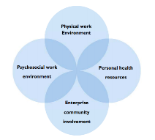
The Physical Work Environment
“The physical work environment refers to the structure, air, machinery, furniture, products, chemicals, materials and production processes in the workplace. These factors can affect workers’ physical safety and health as well as mental health and well-being. In cases where workers perform tasks in a vehicle or outdoors, those vehicles or outdoors locations are also part of the physical work environment.”
(Neira, 2010, p10)

Slide 5
Which hazards in the physical environment have the potential to injure or kill employees?

Slide 6
Globally problems typically include:
chemical hazards (e.g. solvents, pesticides, asbestos, silica, tobacco smoke);
physical hazards (e.g. noise, radiation, vibration, excessive heat, nanoparticles);
biological hazards (e.g. hepatitis B, malaria, HIV, tuberculosis, mould, lack of clean water, toilets and hygiene facilities);
ergonomic hazards (e.g. processes requiring excessive force, awkward posture, repetition, heavy lifting);
mechanical hazards (e.g. machine hazards related to nip points, cranes, forklifts);
energy hazards (e.g. electrical hazards, falls from heights);
mobile hazards (e.g. driving on ice or in rainstorms or in unfamiliar or poorly maintained vehicles).
(Neira, 2010, p10)

Slide 7
How is that managed in the UK?
Legislation
Health and Safety at Work Act, 1974
The Management of Health and Safety at Work Regulations, 1999 – duty to manage risk and record significant findings
Control of Substances Hazardous to Health Regulations, 2002
Workplace (Health, Safety and Welfare) Regulations, 1992 - basic health, safety and welfare issues such as ventilation, heating, lighting, workstations, seating and welfare facilities.
Series of other legislation for managing particular hazards and industries e.g. Manual Handling, Display Screen Equipment, Noise, Lead, Asbestos, Dock work and Construction - see HSE website

Slide 8
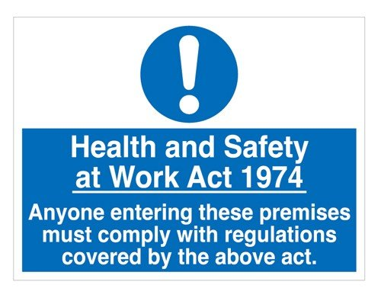
Health and Safety at Work Act 1974
The Act sets out the general duties which employers have towards employees and members of the public, and employees have to themselves and to each other.
These duties are qualified in the Act by the principle of ‘so far as is reasonably practicable’
It is an enabling act for all of the other regulations, which specify the detail under the ‘Act’ that employers must adhere to.

Slide 9
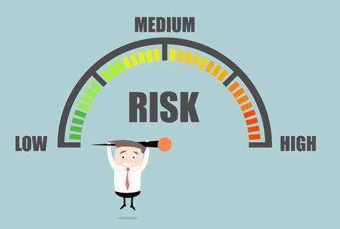
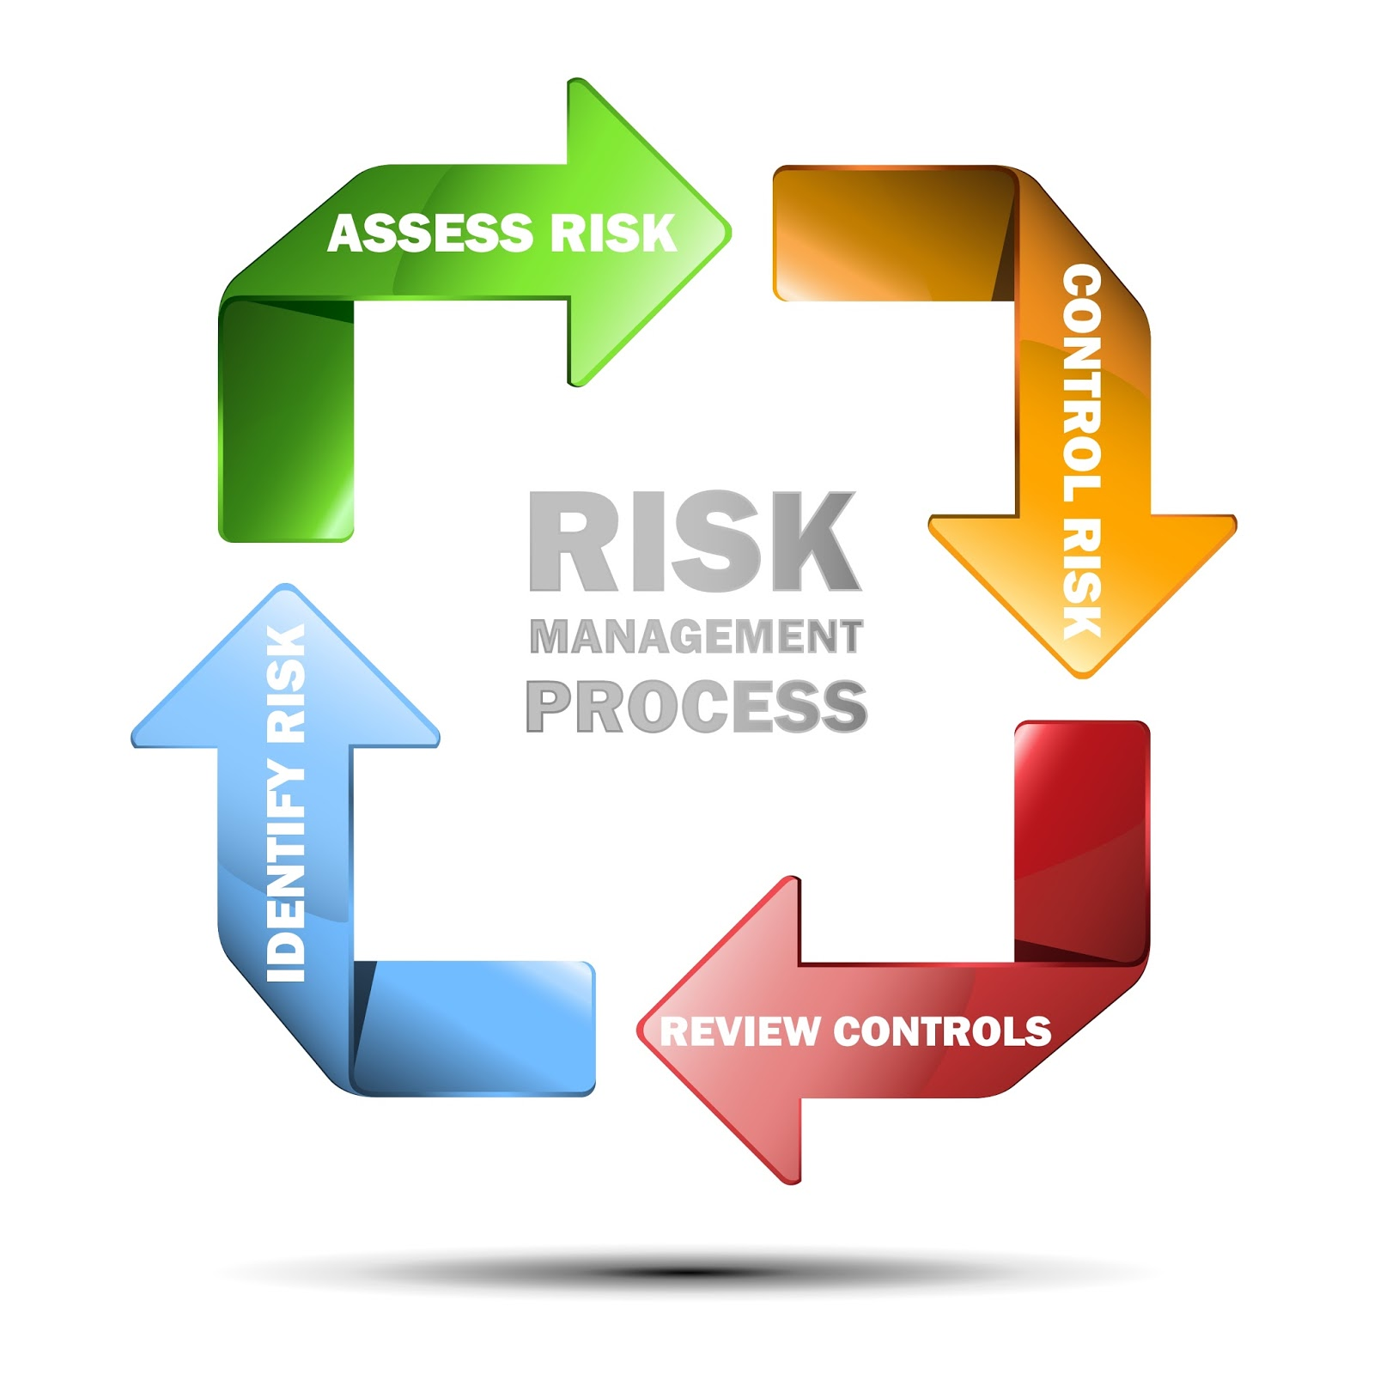
Risk Assessment
a hazard is anything that may cause harm, such as chemicals, electricity, working from ladders, an open drawer etc.
the risk is the chance, high or low, that somebody could be harmed by these and other hazards, together with an indication of how serious the harm could be
5 Steps to risk assessment
Identify the hazards
Decide who might be harmed and how
Evaluate the risks and decide on precautions
Record your significant findings
Review your assessment and update if necessary
See - http://www.hse.gov.uk/risk/controlling-risks.htm

Slide 10
Focus for today
Musculoskeletal
Sleep
Diet
Specific Industry at risk from a broad range of hazards =Construction

Slide 11
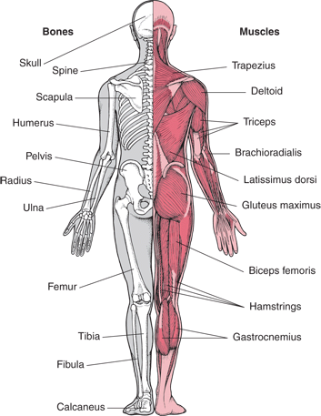
Musculoskeletal Disorders (MSD)
Common pain in working age adults include:
Low back pain
Neck pain
Upper and lower limb pain
MSD’s can affect muscles, joints and
tendons in all parts of the body.

Slide 12
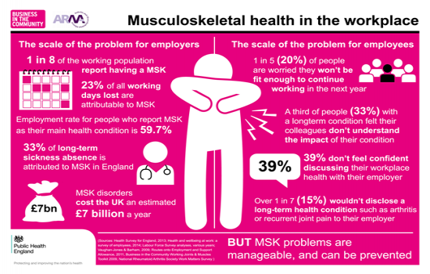
https://wellbeing.bitc.org.uk/all-resources/toolkits/musculoskeletal-health-toolkit-employers?utm_source=Blog&utm_medium=SleepBlog170118&utm_campaign=PHE

Slide 13
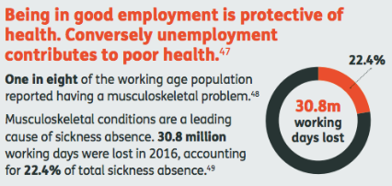
Cause of MSD’s
Disease e.g. arthritis
Obesity
Sedentary lifestyle
Ageing process can, but does not always contribute to risk profile.
Injury

Slide 14
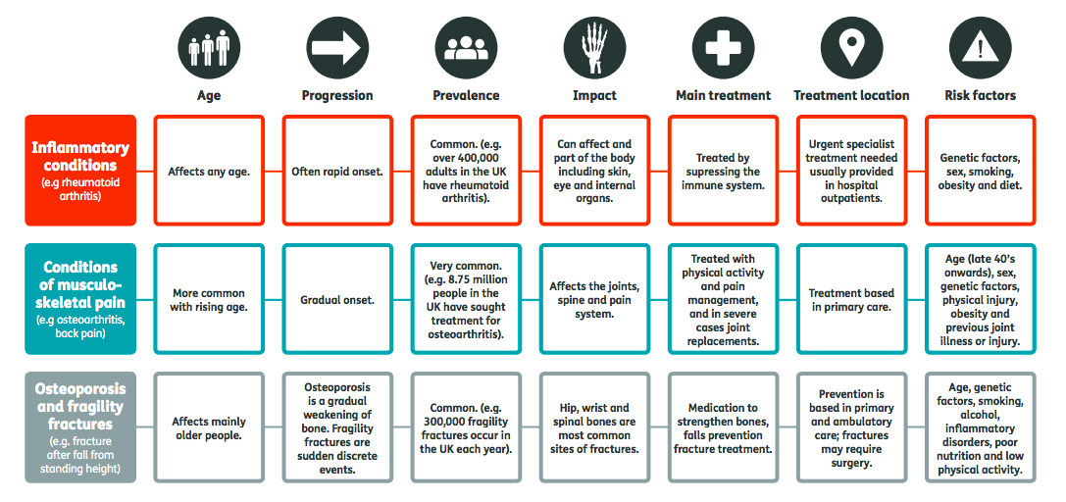
Three groups of Musculoskeletal Conditions

Slide 15
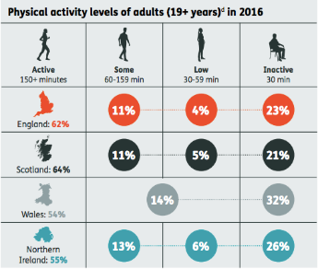
Preventing MSD’s in working Age Population
Physical Activity
Inactive people are at increased risk of developing a painful musculoskeletal condition in later life.
21-32% of adults (19+) in the UK do less than 30 minutes of physical activity per week.
Around 16% of people aged 16-64 in England and Scotland are inactive vs. 40% of people aged over 65.20
Arthritis Research UK (2018) State of Musculoskeletal Health 2018. Available at: https://www.arthritisresearchuk.org/~/media/Files/Data%20and%20stats/State%20of%20MSK/PHS-08_StateOfMSKReport.ashx (accessed 24 October 2018) - see page 9

Slide 16
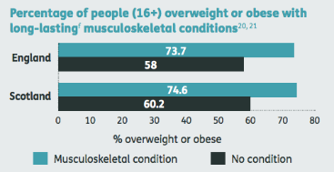
Preventing MSD’s in working Age Population
Obesity
Increases the risk of developing osteoarthritis and need for joint replacement.
Directly damages weight-bearing joints such as knees and hips.
More than twice as likely to develop osteoarthritis of the knee than those of normal body weight.
Increases the risk of developing other musculoskeletal conditions.
People who are obese are four times more likely to develop back pain than those with a healthy body weight.
Being overweight or obese also significantly increases the risk of developing rheumatoid arthritis.

Slide 17
Musculoskeletal Injury at Work
Work-related physical risk factors include:
Manual lifting
Repetitive hand/arm movement (such as computer work)
Awkward body postures
Lack of recovery time
Time constraints on the task
Working with a pre-existing injury
Psychosocial factors such as demanding work and not feeling able to say no.
Traumatic incident

Slide 18
Targeted programmes in the literature
WRULDS – Systematic review finds good evidence for resistance training (Van Eerd et al., 2016)
Neck pain and generalised musculoskeletal pain – Resistance training and strength training benefits office workers (Aderson et al., 2010)
Low back pain and generalised musculoskeletal pain - group based physical exercise and motivational coaching at work improves pain better than individualised physical exercise in leisure time (Jakobsen et al., 2018)
Low back pain – meta-analysis finds moderate evidence that walking is effective (Sitthipornvorakul et al., 2018)

Slide 19
Managing Back Pain in the Workplace
“Evidence-based approaches to the management of back pain have been established since the early 1990s. These are based on the rapid assessment of early-warning symptoms and signs by appropriate healthcare practitioners, such as nurses, physiotherapists and GPs. Where no serious risk factors are identified, the emphasis is on advice, pain relief and rapid rehabilitation through self-help, staying active and supportive physical therapies, to minimise the need for sickness absence.”
Black, C. (2008) Working for a healthier tomorrow: work and health in Britain. London: TSO. p44

Slide 20
How are you going to Promote Musculoskeletal Health at work?

Slide 21
How are you going to Promote Musculoskeletal Health at work?
Change Culture (where necessary) - where staff can ask for help, express their concerns and refuse if they feel that tasks are beyond their capability.
Appoint a champion
Tool box talks to provide essential information
Lifestyle advice and programmes to address obesity, sedentary lifestyle and smoking behaviours
Access to treatment and rehabilitation services and advice
Evaluate
Get leadership on board
Understand and assess the risks
Consult employees
Design an action plan (use a tool kit to help)
Manage the and control the risk, engineer out where possible.
Provide training and communicate expectations

Slide 22
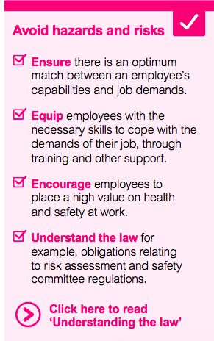
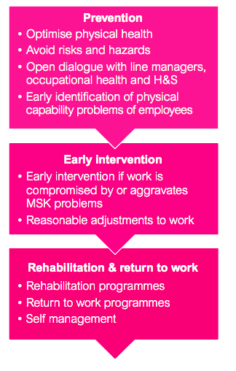
MSK Toolkits
Business in the Community (2017), Musculoskeletal Health in The Workplace: A toolkit for employers. London: BITC Available at: https://wellbeing.bitc.org.uk/sites/default/files/business_in_the_community_musculoskeletal_toolkit.pdf (accessed 26 October 2018)

Slide 23
Moving and Handling Loads – Key Principles
Risk assess the process!
Avoid moving and handling where possible
Mechanise the process
Make the load smaller
Ensure the load is stable
Use specialist equipment
Avoid carrying loads over distance
Provide staff with manual handling training

Slide 24


Shift work and Circadian Rhythms
https://youtu.be/2BoLqqNuqwA

Slide 25
Shift work and Circadian Rhythms
Breast Cancer
Diabetes
Heart Disease
Sleep disorders and problems
Gastro-intestinal disorders
Accidents, impaired vigilance/lapses in concentration
Depression
Metabolic disease

Slide 26

Sleep
Sleep plays a role in:
metabolic regulation
emotion regulation
performance
memory consolidation
brain recuperation processes
learning
physical recovery

Slide 27
Shift work can interfere with Circadian rhythms. What else affects the ability to and the quality of our sleep?

Slide 28
What affects the ability to and the quality of our sleep?
Alcohol, Caffeine, tobacco and other stimulants
Some prescribed medication
Blue Light from tablets, phones, PC
Being over stimulated
Being too tired
Eating too much before bed
Too many ideas
Exercising late in the day
Aging
Hormones
Worry and anxiety
Pain
Sleep apnoea
The sleep environment itself
Dehydration
Caring responsibilities

Slide 29
Insufficient Sleep (Perry et al., 2013)
Contributes to and exacerbate chronic health conditions
Less than 7 hours night - increases likelihood:
cardiovascular morbidity
metabolic disorders such as glucose intolerance, which may lead to obesity, diabetes, heart disease, and hypertension.
Death from heart disease and stroke
Insufficient sleep also affects:
immunologic function
development of mood disorders and is associated with depression;
deficits in cognition, memory and learning;
reduced quality of life
Adults who sleep fewer than 7 hours per night have greater difficulty concentrating, remembering, and performing other daily activities.
Implicated in workplace injury, accidents, poor decision making and medical errors

Slide 30
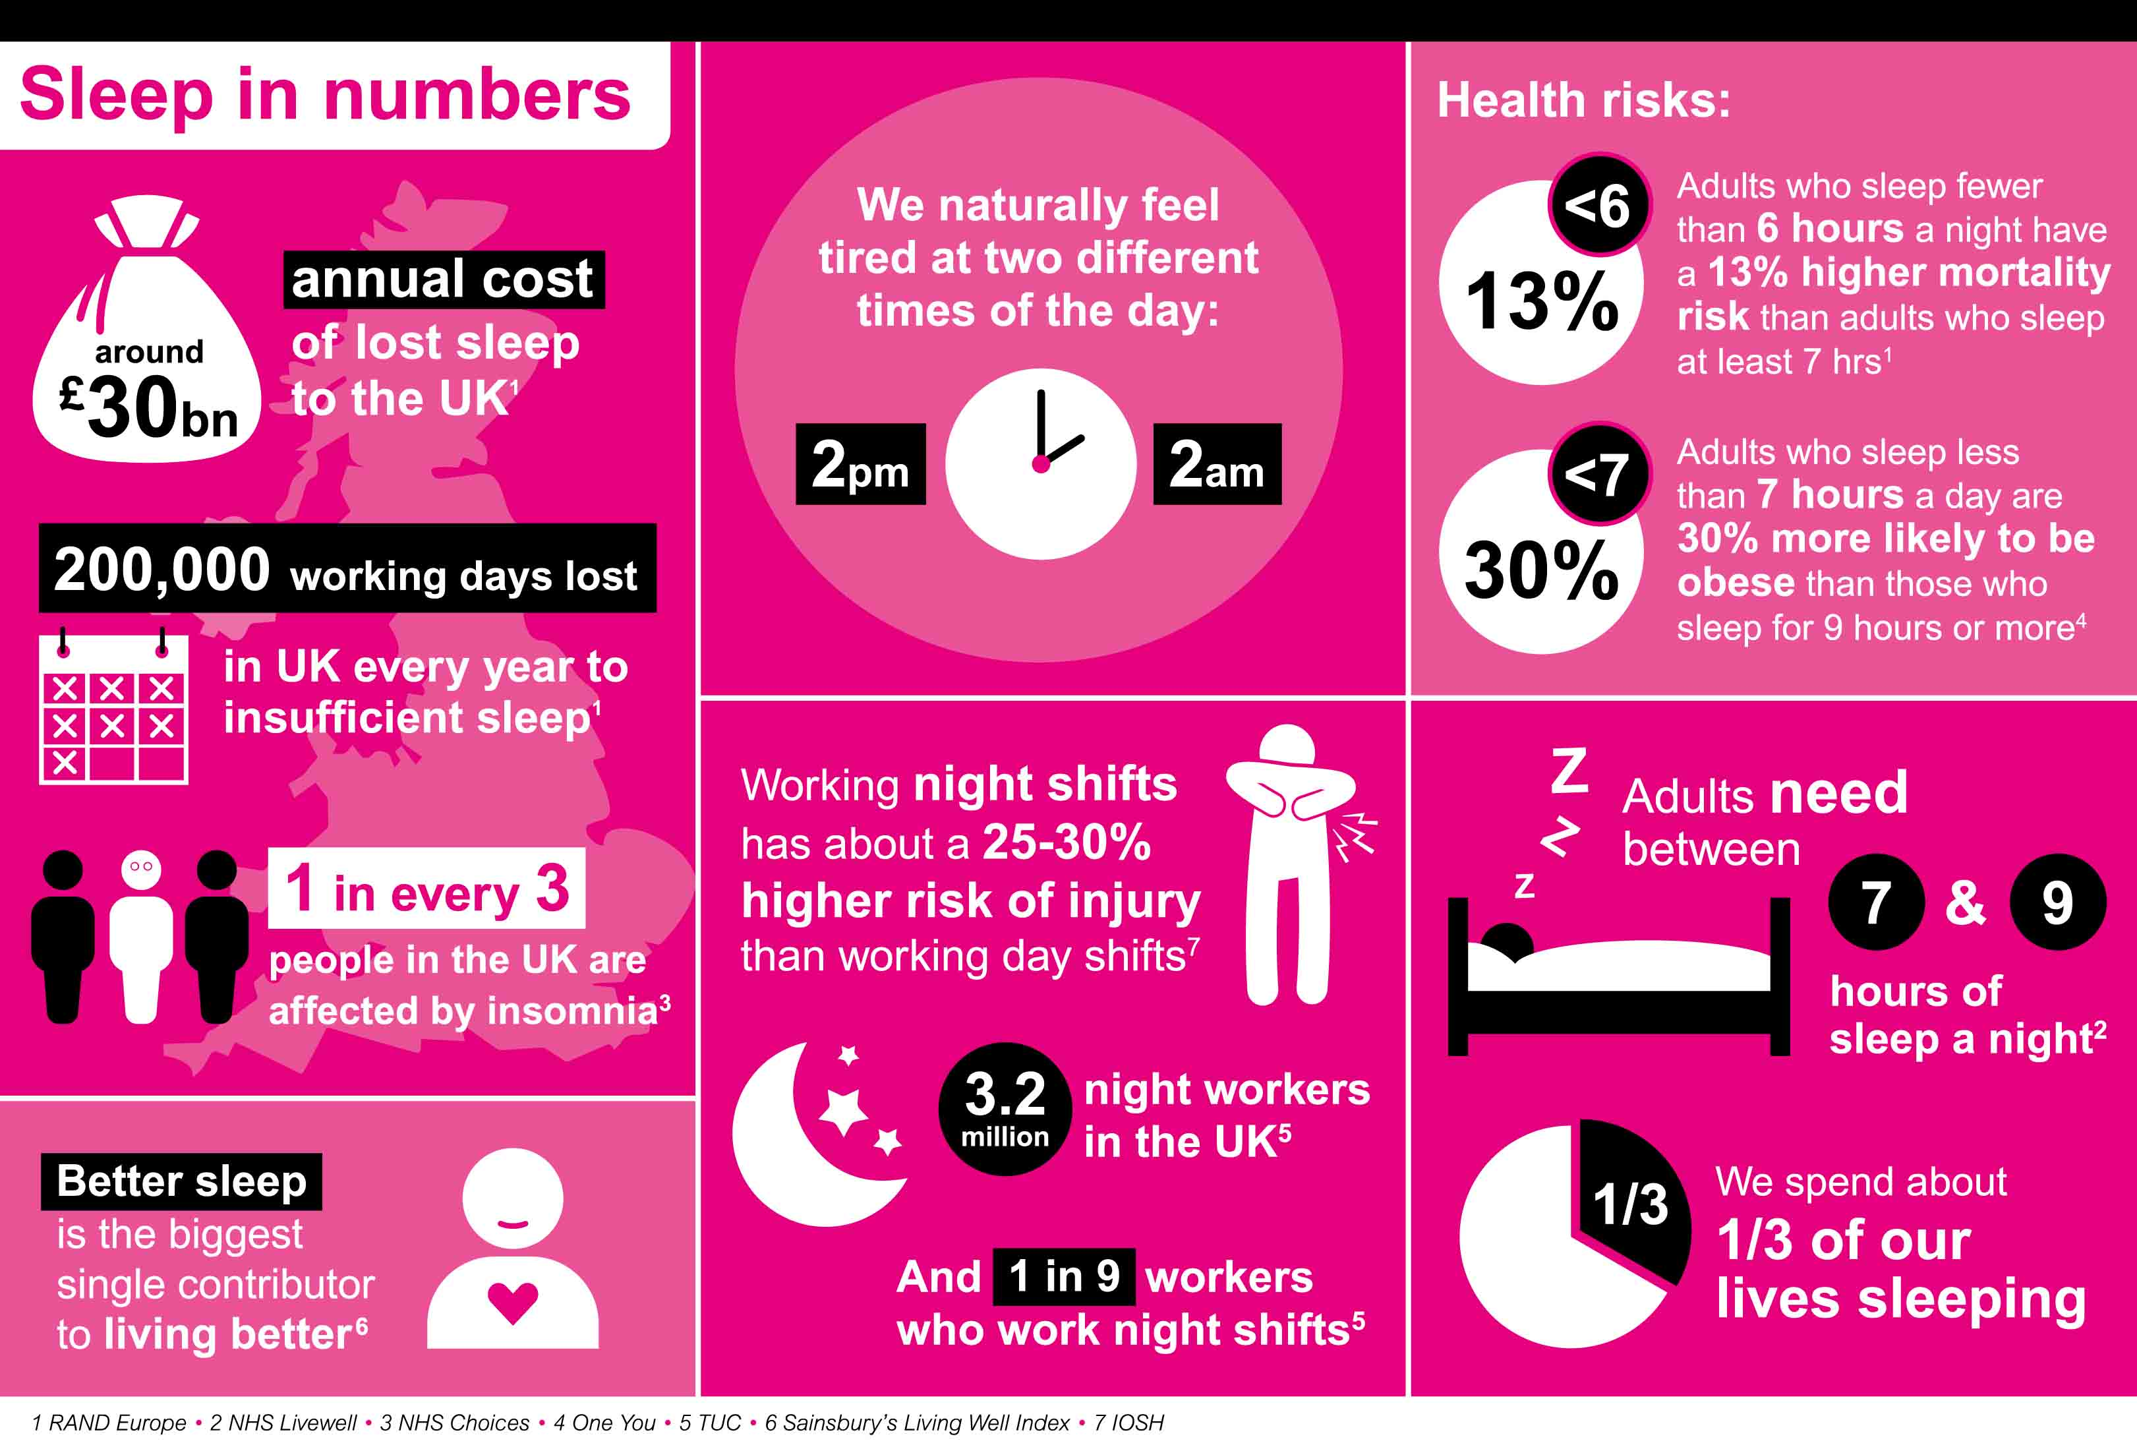

Slide 31
Design an advice pack for employees about getting a good night’s sleep

Slide 32
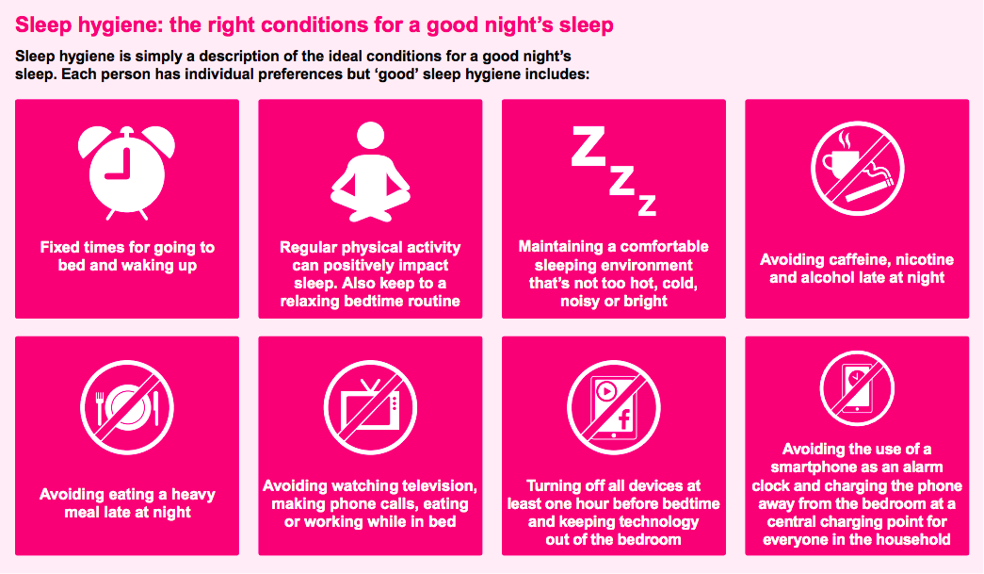
Sleep Hygiene Practice

Slide 33
What health promoting activity should employers do?
Create a culture to support staff get the rest they need e.g. not expecting response to texts and emails after hours
Risk assessment process might benefit staff if high risk work or where data suggests there may be a problem
Sleep audits and consultations - Evaluate stress levels
Provide opportunities for staff
Recognise where staff are sleep deprived and act to remedy the situation including referral to medical advisors
Provide information and advice about sleep hygiene and self care tools
Attention to work-life balance, walking meetings, hydration and breaks from screen work.
Staff to take full holiday entitlement.
Also see: Business in the Community (2018), Sleep and recovery: A toolkit for employers. London: BITC Available at: https://wellbeing.bitc.org.uk/sites/default/files/business_in_the_community_musculoskeletal_toolkit.pdf (accessed 26 October 2018)

Slide 34

Food and the Workplace

Slide 35
How does the workplace influence our what we eat?

Slide 36
Diet
Availability of food
Type of food
Affordability
Dedicated places to eat
Breaks
Preparation areas
Storage
Social events
Psychosocial factors
Workplace health, safety and welfare. Workplace (Health, Safety and Welfare) Regulations 1992.
Workers have the right to one uninterrupted 20 minute rest break during their working day, if they work more than 6 hours a day. This could be a tea or lunch break.
Workplace wellbeing charter

Slide 37
Health Promotion for Healthy Eating at Work
Educate your workforce
Healthy swaps and Healthy snacks
Traffic light system
Healthy option as the easy option
Portion sizes
Ensure food meets an appropriate calorific intake for the work being done.
Kitchen and crockery to enable staff to bring and prepare their own food.
Alcohol policy
Provide free water and low cost hot drinks
Rolling schedule of healthy eating events e.g. picnic or Recipe Share
Healthy Eating Champion
Link to culture of the organisation e.g. competition, being healthy etc...

Slide 38
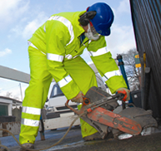
Construction Industry
Hazardous substances
Construction dust
Cement
Lead
Solvents
Isocyanates
Micro-organisms
Carbon Monoxide
Carcinogens e.g. asbestos and silica, diesel emissions
Physical Health Risks
Noise
Vibration
Manual Handling
Repetitive Work
Working at Height
Working outside – UV exposure through solar radiation

Slide 39
Construction Other Issues
Male Dominated Industry - culture
Men’s Health Issues
Access to GP and health checks
Access to treatment
Protective Equipment
High Suicide Risk
Overweight and Obesity
Insect Bites
Access to healthy diet
Migrant workers
Hygiene needs and safe places to eat
VIDEO: SUN SAFTY IN CONSTRUCTION: https://youtu.be/i1vEuLdOgnw

Slide 40
Directed Study
Read van der Molen et al (2004), ‘World at work: Bricklayers and bricklayers’ assistants’, Occupational and Environmental Medicine, 61, pp. 89-93. Available at: https://oem.bmj.com/content/61/1/89 (accessed: 24 October, 2018)
Visit the No Time To Lose Website: https://www.notimetolose.org.uk/
Find out about one occupational cancer and think about what needs to be done to protect employees and prevent cancer of this type. What health education messages should be given to employees?

Slide 41
MSD References
Anderson, L.L., Christensen, K.B., Holterman, A. et al. (2010) ‘Effect of physical exercise interventions on musculoskeletal pain in all body regions among office workers: A one-year randomized controlled trial’, Manual Therapy, 15 (1), pp. 100-104, Available at: https://www.sciencedirect.com/science/article/pii/S1356689X09001374#! (accessed 24 October 2018)
Jackobsen, M.D., Sundstrup, E., Brandt, M. and Anderson, L.L. (2018) ‘Effect of physical exercise on musculoskeletal pain in multiple body regions among healthcare workers: Secondary analysis of a cluster randomized controlled trial’, Musculoskeletal Science and Practice, 34, pp.89-96 Available at: https://www.sciencedirect.com/science/article/pii/S2468781218300262 (accessed 24 October 2018)
Sitthipornvorakul, E., Klinsophen, T., Sihawong, R. and Janwantanakul, P. (2018)’ The effects of walking intervention in patients with chronic low back pain: A meta-analysis of randomized controlled trials’, Musculoskeletal Science and Practice, 34, pp. 38-46 Available at: https://www.sciencedirect.com/science/article/pii/S2468781217301820#! (accessed 24 October 2018)
Van Eerd, D., Munhall, C., Irvin, E,, et al (2016)’Effectiveness of workplace interventions in the prevention of upper extremity musculoskeletal disorders and symptoms: an update of the evidence’, Occup Environ Med, 73, page 62-70 Available at: https://oem.bmj.com/content/73/1/62 (accessed 24 October 2018)

Slide 42
Shift work and Circadian Rhythms and Sleep References
Boivrin, D.B. and Boudreau, P. (2014), ‘Impact of shift work on sleep and circadian rhythms’, Patholgie Biologie, 62 (5), pp 292- 301, https://doi.org/10.1016/j.patbio.2014.08.001
Costa, G. (2010), ‘Shift work and health: current problems and preventative actions’, Safety and Health at Work, 1 (2), pp.112 -123 https://doi.org/10.5491/SHAW.2010.1.2.112
Grundy, A., Richardson, H., Burstyn, I., et al. (2013),’Increased risk of breast cancer associated with long-term shift work in Canada’ Occup Environ Med ,70 pp. 831-838. https://oem.bmj.com/content/70/12/831
Perry, G.S., Patil, S.P. and Presley-Cantrell, L.R. (2013), ‘Raising awareness as sleep as a healthy behaviour’, Preventing Chronic Disease, 10, E133 Available at: https://www.ncbi.nlm.nih.gov/pmc/articles/PMC3741412/ (accessed 26 October 2018)

